Slide 1
进度报告20170804 CCA 结果分析
李佳蔚

Slide 2
CCA speaker listener
频段选择：broadband 0.5-40Hz

Slide 3
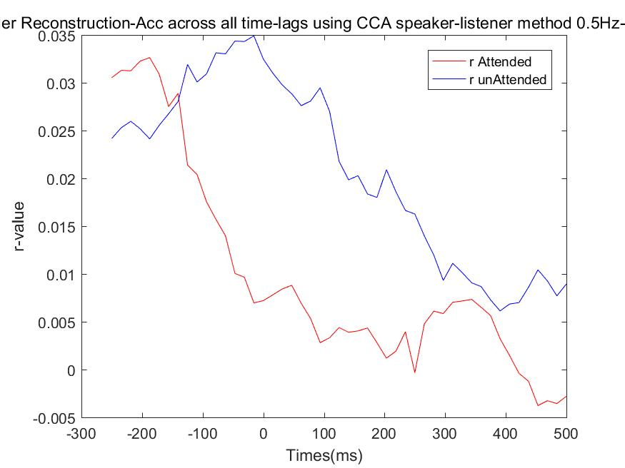
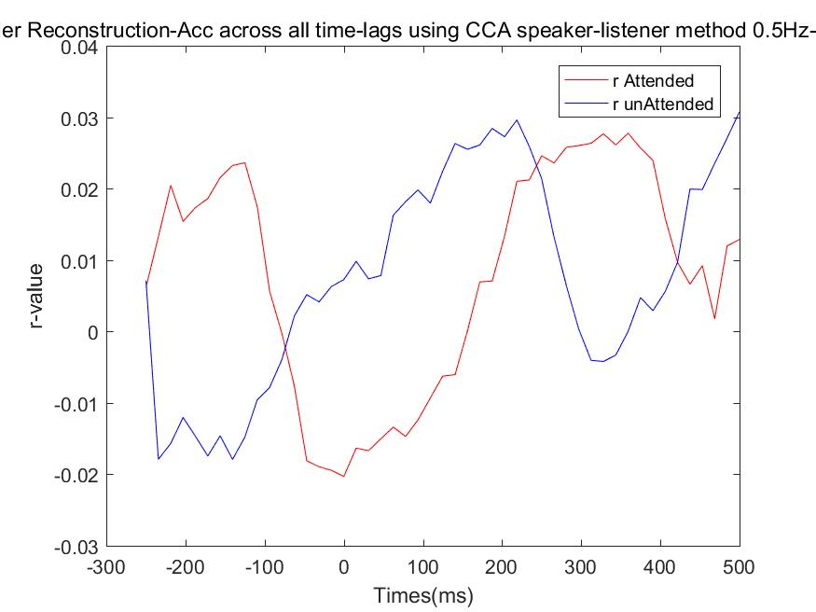
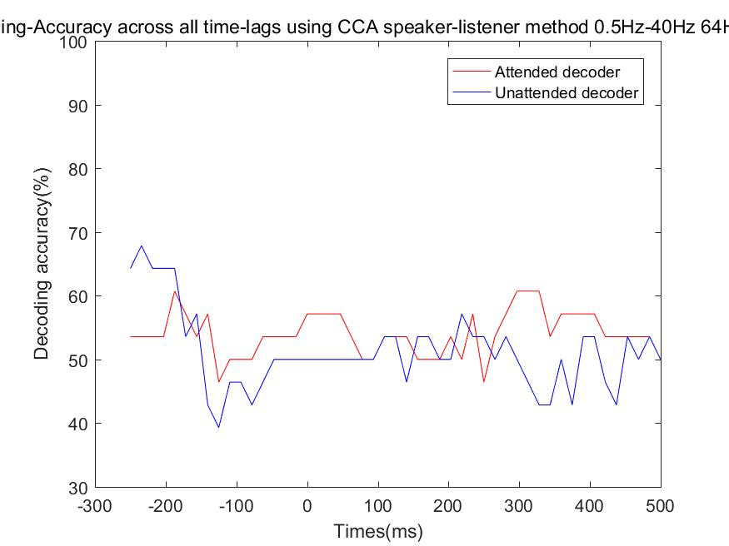
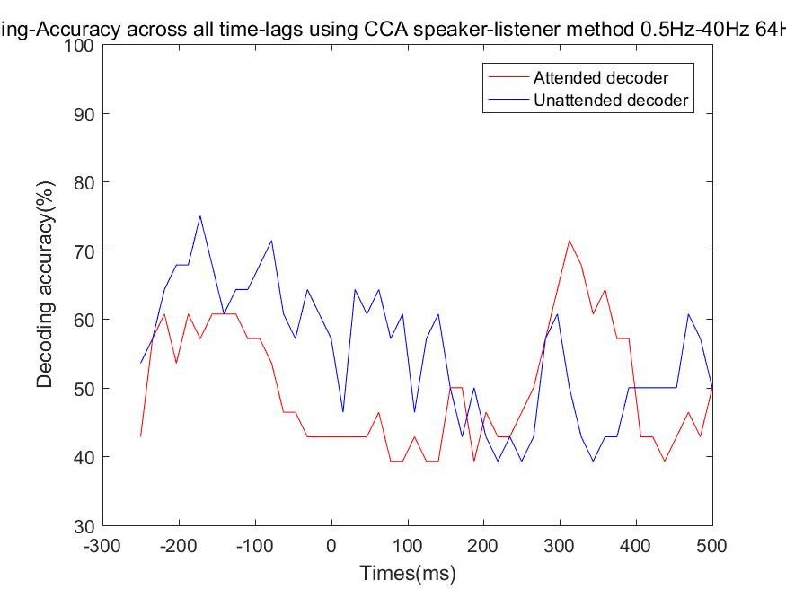
CCA speaker listener – listener11
R rank1
R rank3
r value
Decoding result

Slide 4
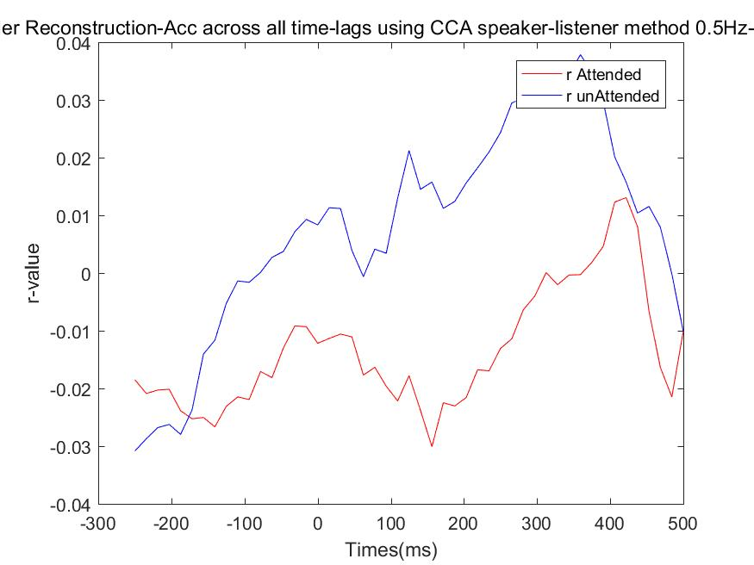
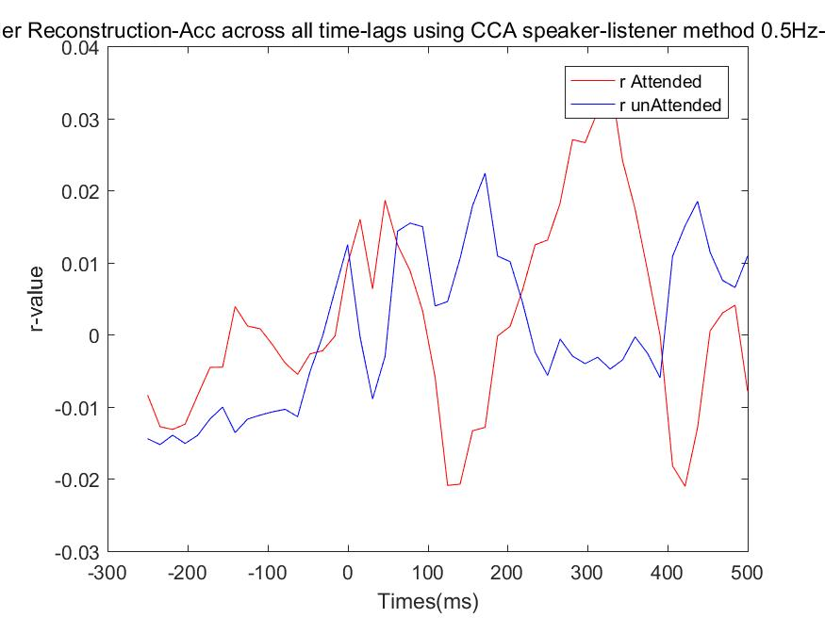
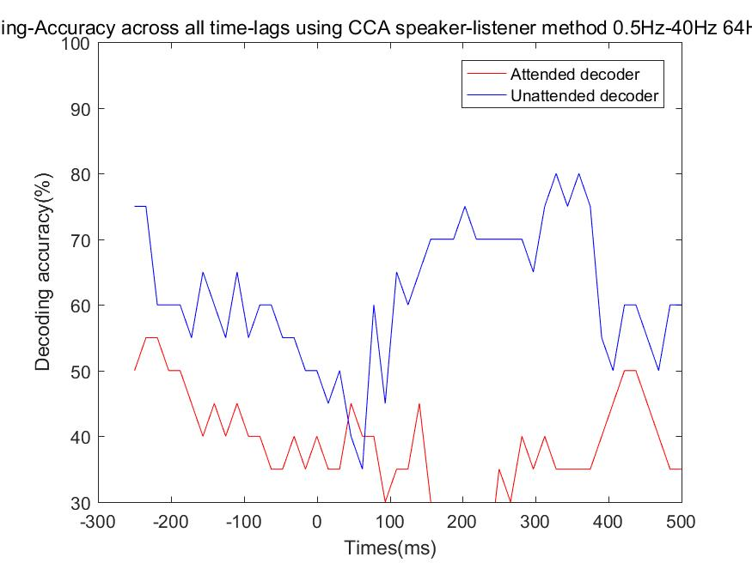
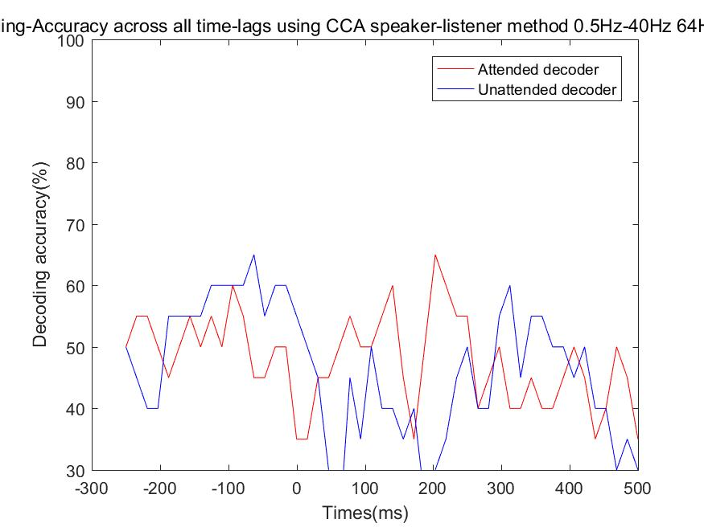
CCA speaker listener – listener12
R rank1
R rank2
r value
Decoding result

Slide 5
Thanks！

